Slide 1
Principal Components Analysis ( PCA)
An exploratory technique used to reduce the dimensionality of the data set to 2D or 3D
Can be used to:
  Reduce number of dimensions in data
  Find patterns in high-dimensional data
  Visualize data of high dimensionality
Example applications:
  Face recognition
  Image compression
  Gene expression analysis

Slide 2
Principal Components Analysis Ideas ( PCA)
Does the data set ‘span’ the whole of d dimensional space?
For a matrix of m samples x n genes, create a new covariance matrix of size n x n.
Transform some large number of variables into a smaller number of uncorrelated variables called principal components (PCs).
developed to capture as much of the variation in data as possible

Slide 3
Principal Component Analysis
  See online tutorials such as http://www.cs.otago.ac.nz/cosc453/student_tutorials/principal_components.pdf
X2
Y1
Y2
x
x
x
x
Note: Y1 is the first eigen vector,
Y2 is the second. Y2 ignorable.
x
x
x
x
x
x
x
x
x
x
x
x
x
X1
x
x
x
Key observation:
variance = largest!
x
x
x
x
x

Slide 4
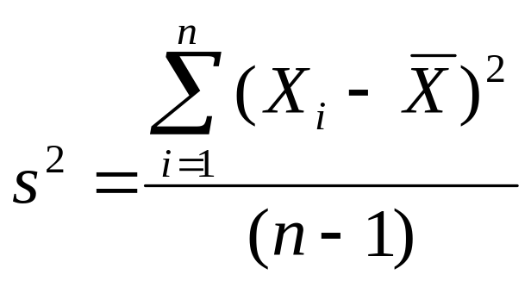
Principal Component Analysis: one attribute first
Temperature
42
40
24
30
15
18
15
30
15
30
35
30
40
30
Question: how much spread is in the data along the axis? (distance to the mean)
Variance=Standard deviation^2

Slide 5
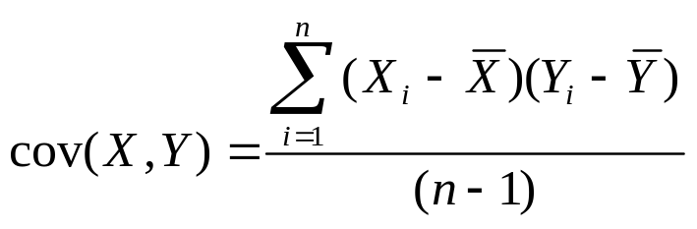
Now consider two dimensions
X=Temperature | Y=Humidity
40 | 90
40 | 90
40 | 90
30 | 90
15 | 70
15 | 70
15 | 70
30 | 90
15 | 70
30 | 70
30 | 70
30 | 90
40 | 70
30 | 90
Covariance: measures the
correlation between X and Y
cov(X,Y)=0: independent
Cov(X,Y)>0: move same dir
Cov(X,Y)<0: move oppo dir

Slide 6
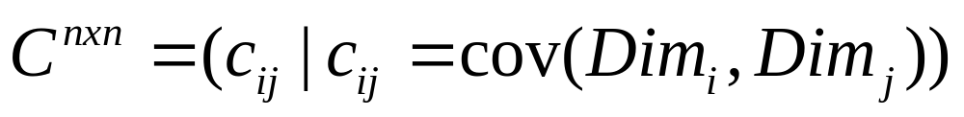
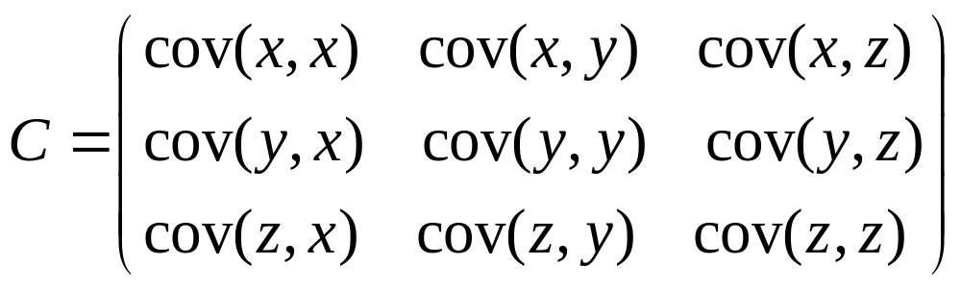
More than two attributes: covariance matrix
Contains covariance values between all possible dimensions (=attributes):
Example for three attributes (x,y,z):

Slide 7
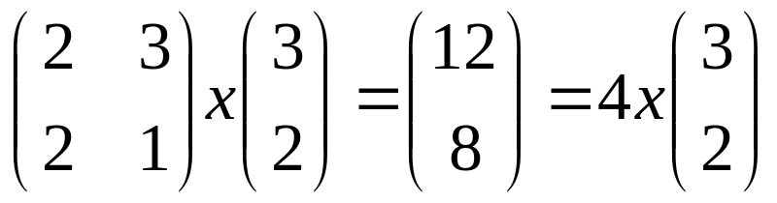
Eigenvalues & eigenvectors
Vectors x having same direction as Ax are called eigenvectors of A (A is an n by n matrix).
In the equation Ax=λx, λ is called an eigenvalue of A.

Slide 8
Eigenvalues & eigenvectors
Ax=λx ⇔ (A-λI)x=0
How to calculate x and λ:
  Calculate det(A-λI), yields a polynomial (degree n)
  Determine roots to det(A-λI)=0, roots are eigenvalues λ
  Solve (A- λI) x=0 for each λ to obtain eigenvectors x

Slide 9
Principal components
1. principal component (PC1)
  The eigenvalue with the largest absolute value will indicate that the data have the largest variance along its eigenvector, the direction along which there is greatest variation
2. principal component (PC2)
  the direction with maximum variation left in data, orthogonal to the 1. PC
In general, only few directions manage to capture most of the variability in the data.

Slide 10

Steps of PCA
Let be the mean vector (taking the mean of all rows)
Adjust the original data by the mean
  X’ = X –
Compute the covariance matrix C of adjusted X
Find the eigenvectors and eigenvalues of C.
For matrix C, vectors e (=column vector) having same direction as Ce :
  eigenvectors of C is e such that Ce=λe,
  λ is called an eigenvalue of C.
Ce=λe ⇔ (C-λI)e=0
  Most data mining packages do this for you.

Slide 11
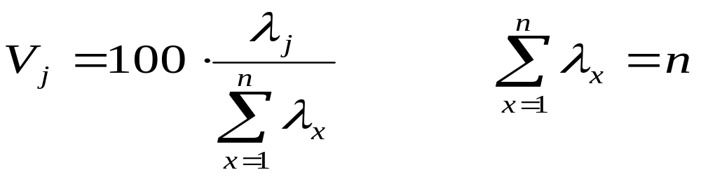
Eigenvalues
Calculate eigenvalues λ and eigenvectors x for covariance matrix:
  Eigenvalues λ_{j} are used for calculation of [% of total variance] (V_{j}) for each component j:

Slide 12
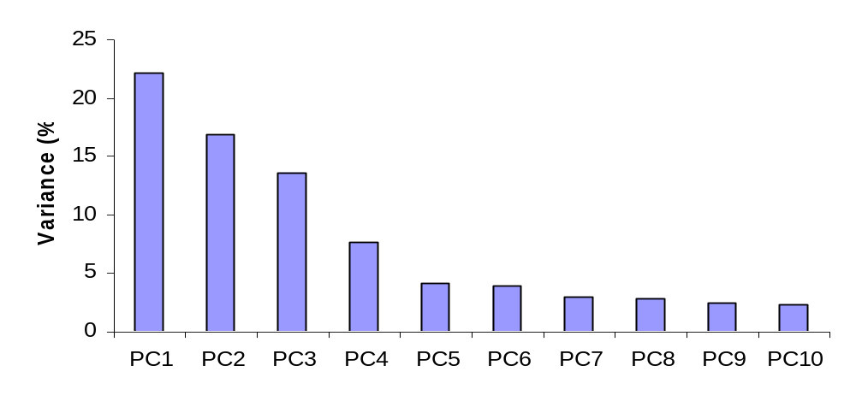
Principal components - Variance

Slide 13
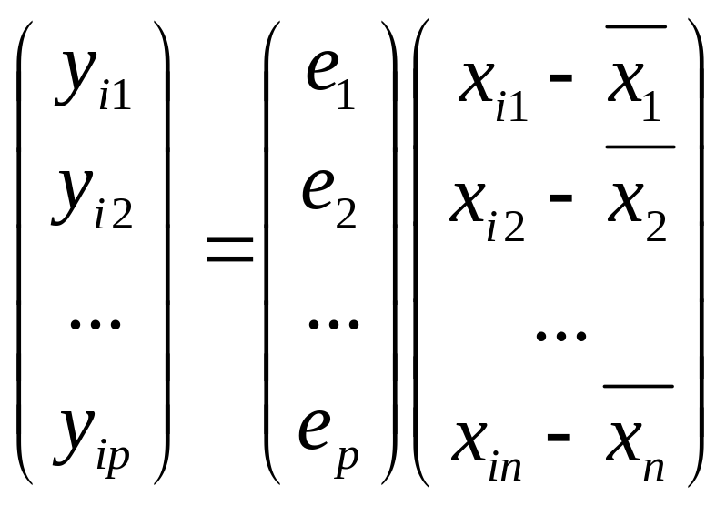
Transformed Data
Eigenvalues λ_{j} corresponds to variance on each component j
Thus, sort by λ_{j}
Take the first p eigenvectors e_{i;} where p is the number of top eigenvalues
These are the directions with the largest variances

Slide 14
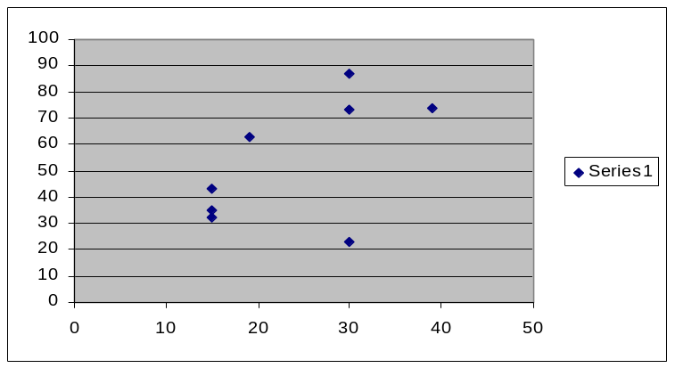
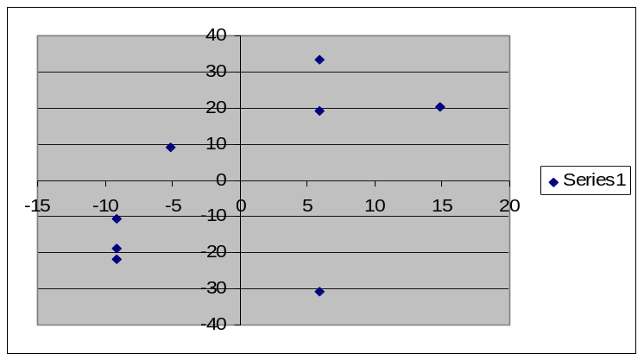
An Example
Mean1=24.1
Mean2=53.8
X1 | X2 | X1' | X2'
19 | 63 | -5.1 | 9.25
39 | 74 | 14.9 | 20.25
30 | 87 | 5.9 | 33.25
30 | 23 | 5.9 | -30.75
15 | 35 | -9.1 | -18.75
15 | 43 | -9.1 | -10.75
15 | 32 | -9.1 | -21.75
30 | 73 | 5.9 | 19.25

Slide 15
Covariance Matrix
75 | 106
106 | 482
C=
Using MATLAB, we find out:
  Eigenvectors:
  e1=(-0.98,-0.21), λ1=51.8
  e2=(0.21,-0.98), λ2=560.2
  Thus the second eigenvector is more important!

Slide 16
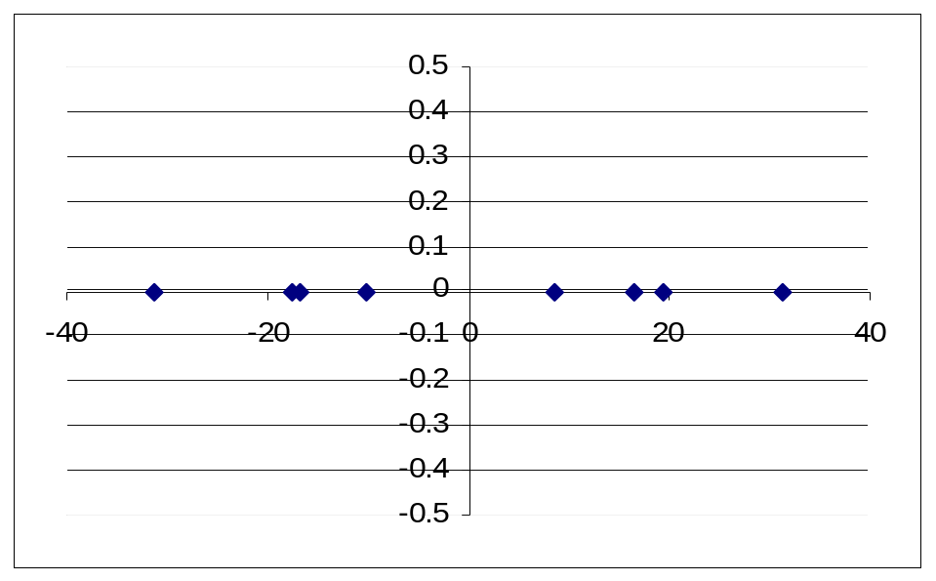
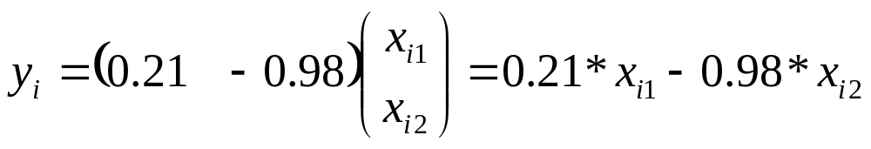
If we only keep one dimension: e2
yi
-10.14
-16.72
-31.35
31.374
16.464
8.624
19.404
-17.63
We keep the dimension of e2=(0.21,-0.98)
We can obtain the final data as

Slide 17
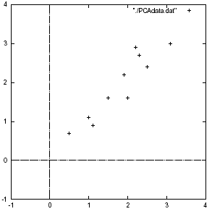
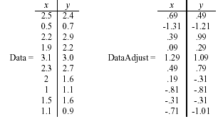

Slide 18
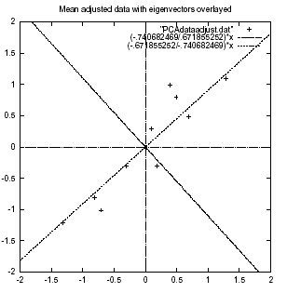

Slide 19
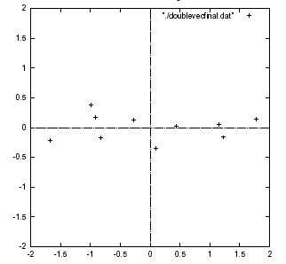
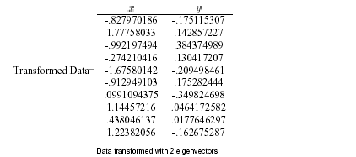

Slide 20
PCA –> Original Data
Retrieving old data (e.g. in data compression)
  RetrievedRowData=(RowFeatureVector^{T} x FinalData)+OriginalMean
  Yields original data using the chosen components

Slide 21
Principal components
General about principal components
  summary variables
  linear combinations of the original variables
  uncorrelated with each other
  capture as much of the original variance as possible

Slide 22
Applications – Gene expression analysis
Reference: Raychaudhuri et al. (2000)
Purpose: Determine core set of conditions for useful
gene comparison
Dimensions: conditions, observations: genes
Yeast sporulation dataset (7 conditions, 6118 genes)
Result: Two components capture most of variability (90%)
Issues: uneven data intervals, data dependencies
PCA is common prior to clustering
Crisp clustering questioned : genes may correlate with multiple clusters
Alternative: determination of gene’s closest neighbours

Slide 23
Two Way (Angle) Data Analysis
Genes 10³–10⁴
Conditions 10¹–10²
Gene expression matrix
Genes 10³-10⁴
Gene expression matrix
Samples 10¹-10²
Sample space analysis
Gene space analysis

Slide 24
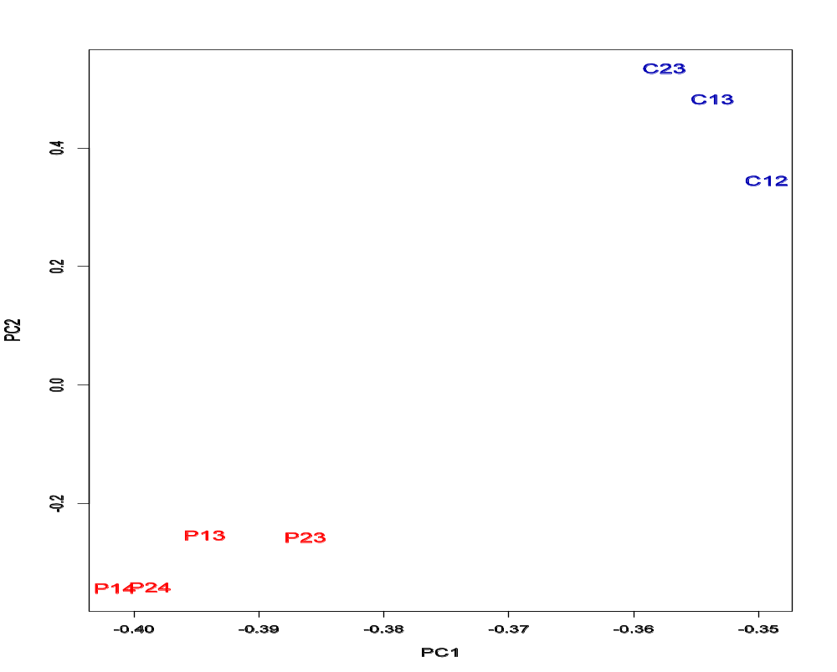
PCA - example

Slide 25
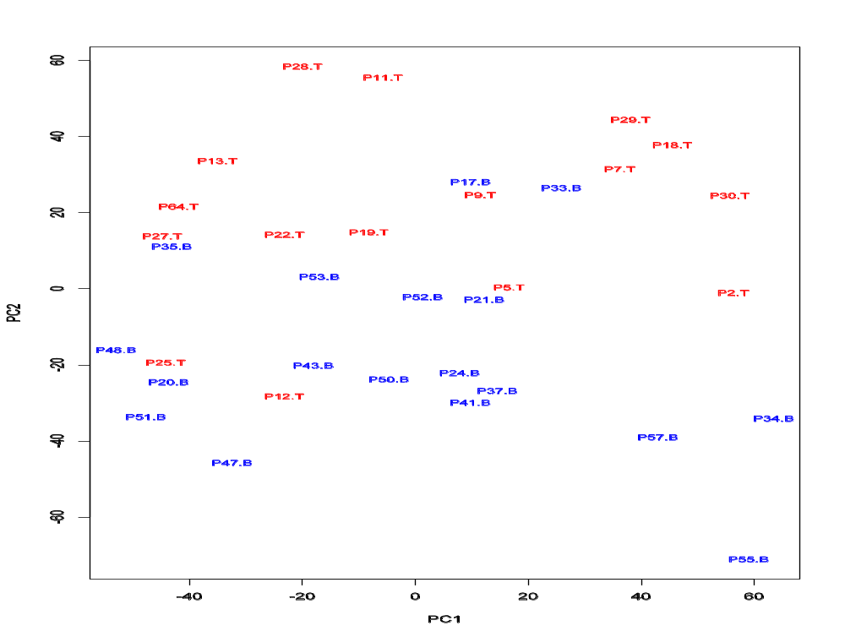
PCA on all Genes
Leukemia data, precursor B and T
Plot of 34 patients, dimension of 8973 genes reduced to 2

Slide 26
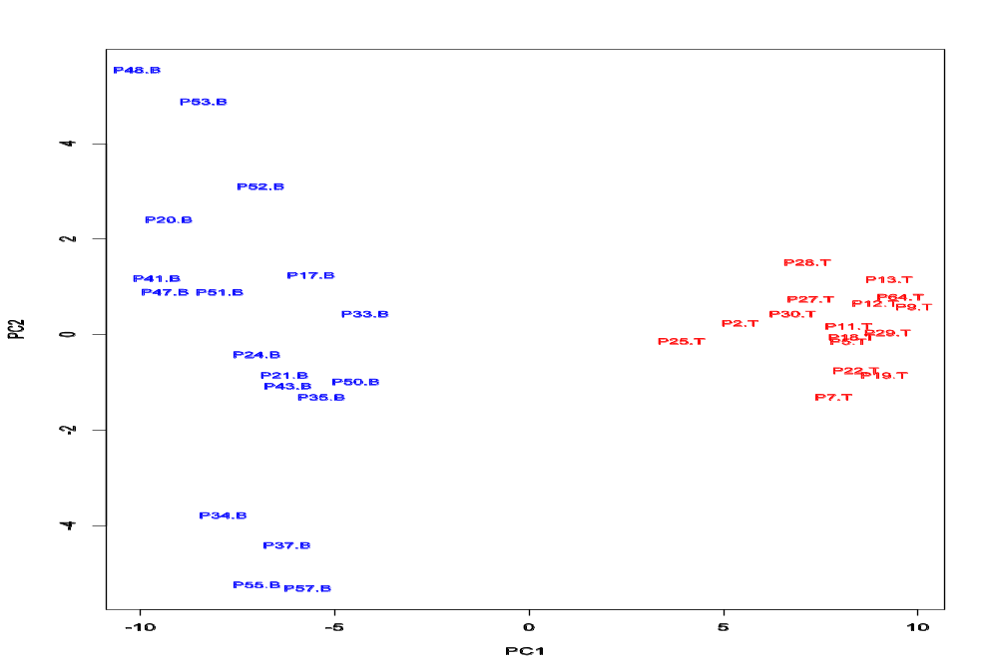
PCA on 100 top significant genes
Leukemia data, precursor B and T
Plot of 34 patients, dimension of 100 genes reduced to 2

Slide 27
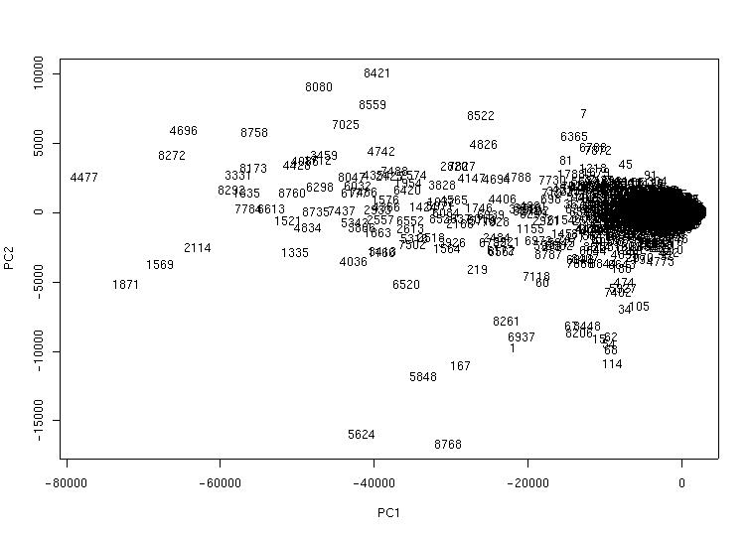
PCA of genes (Leukemia data)
Plot of 8973 genes, dimension of 34 patients reduced to 2

